Slide 1
Automated Cartography Solutions (ACS)
Providing A New Automated Mapping Solution

Slide 2
Our Members
Jake Streett – App Developer
Scott Efird – Server and Database Administrator
Sam Smith – Drone Pilot and Website Developer

Slide 3
The Problem
Google Maps provides users with satellite images of the world. That is great, but the images are update infrequently (1-3 years)
//PICTURE OF GOOGLE MAPS UNABLE TO DISPLAY DATA

Slide 4
Potential Uses
Who needs more update maps?
Open face mines
Construction companies
Farmers (cattle counts)
Disaster Reconnaissance
…ect?

Slide 5
The Solution
ACS! Automated Cartography Solutions.
What is required?
A Drone and a Phone! That is it.
//PICTURE OF MAP OVERLAYED WITH OUR RENDER
Our solution is a cheap and easy to implement and can be done by hobbies to corporations.

Slide 6
How It Works
The user opens the ACS App, selects a region they wish to map, connects the phone to the drone and that is it! The phone will take pictures as the drone flies and upload them to our server. Once our server has the pictures it stiches them together and overlays them on Google Maps on our website so that users can have the most up to date satellite imagery.

Slide 7
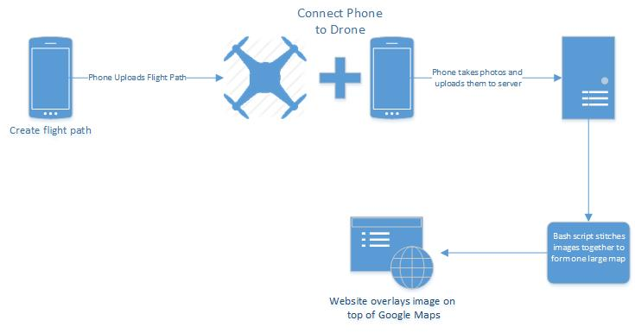
Project Overview

Slide 8
Cost
AeroSky P 12 Quadcopter “ready to fly” = 449.95
*OtterBox Defender Series Case = 45.95
//Cost of phone?
Total: 495.90
*The OtterBox case and clip is used for attaching the phone to the drone.

Slide 9
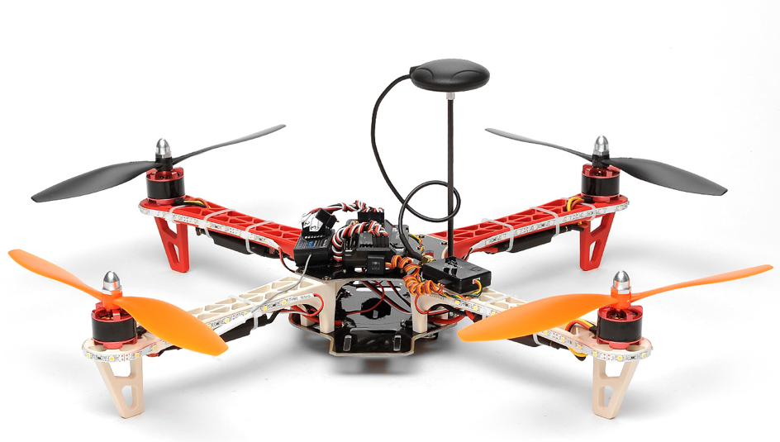
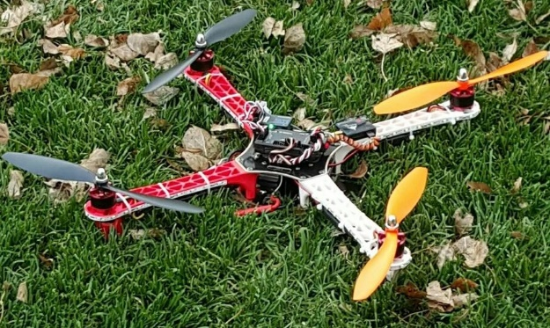
Drone
The drone we used for this project was a AeroSky P12 Quadcopter.
It came with:
APM 2.5 autopilot board
3-axis gyro
Accelerometer
Magnetometer
High-performance Barometer
U-blox NEO-6M GPS module.
Accuracy:
Position 2.5 m CEP
SBAS 2.0 m CEP

Slide 10
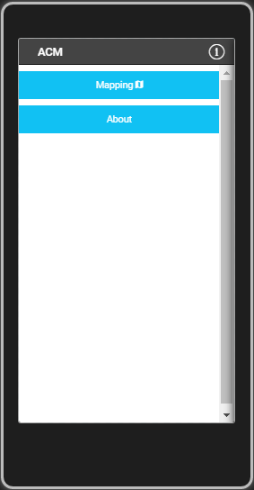
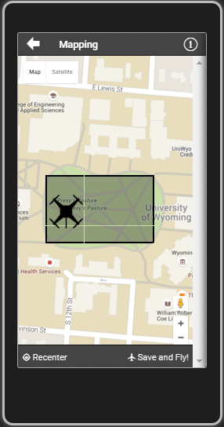
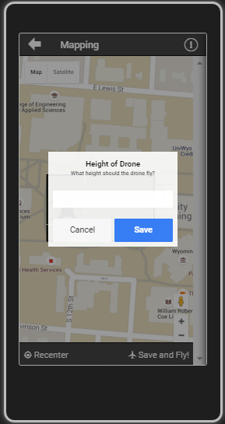
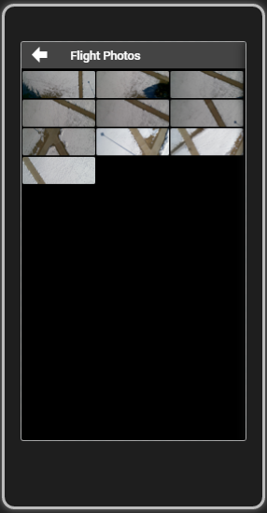
ACS App

Slide 11
App Overview
This app is a cross platform app which is built using the following library's:
AngularJS (1.4)
Apache Cordova (3.5.1)
Ionic(1.2.4)
jQuery
It creates and uploads a flight path to the Drone.
It also takes and upload photos to the server.

Slide 12
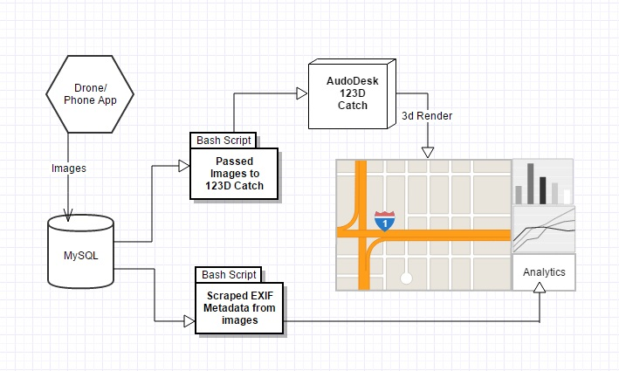
Server Infrastructure Overview

Slide 13

Primary Database Server
Running Xubuntu 15.10
Uses MySQL to hold the images
Uses several bash scripts
to process the images
HP ProLiant DL320

Slide 14
Server Side Code
Formats images to a uniform size
Scrapes image metadata
Enforces image naming conventions
Creates a master content list
Passes images to Autodesk 123D Catch

Slide 15
Autodesk 123D Catch
Creates 3D objects using a large set of images
Originally we created a system using ImageMagick and Javascript
Now we record video with the phone and scrape images from it using VLC Player

Slide 16
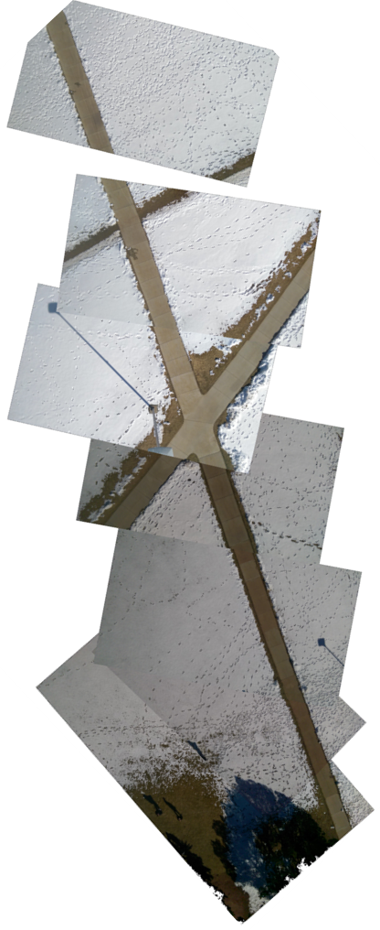
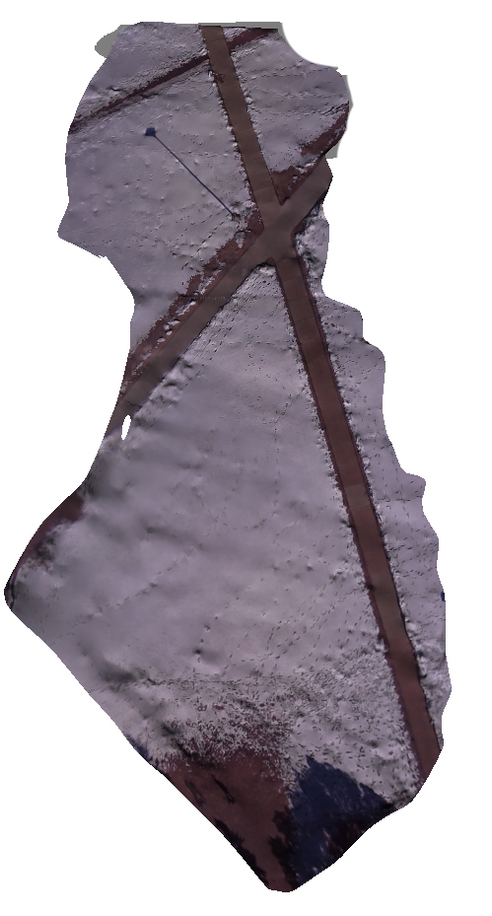
The same data displayed using Autodesk 123D Catch
Our original map

Slide 17
//I NEED A TITLE

Slide 18
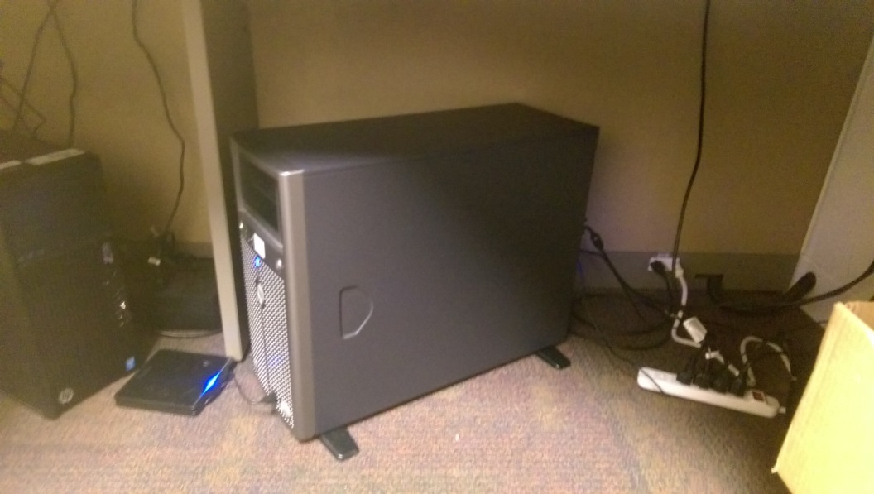
Website
Using Bootstrap, Ajax and Javascript
Acts as a hub for all our public facing systems
In the future, directly tie into the app

Slide 19
Analytical Information
Using data both from the drone’s flight path and from the phone we can run high level analytics.
Average speed, estimated distance between images, GPS information.
Could be compiled into an automated report that can be emailed to the user after each flight.

Slide 20
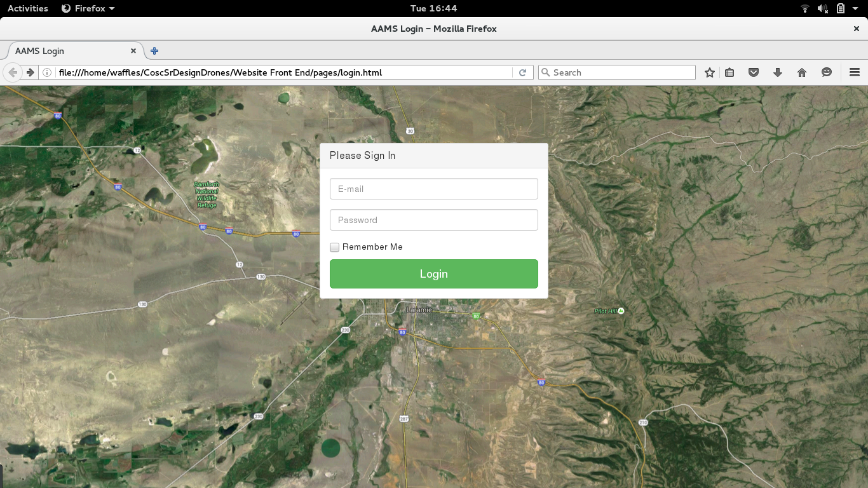

Slide 21
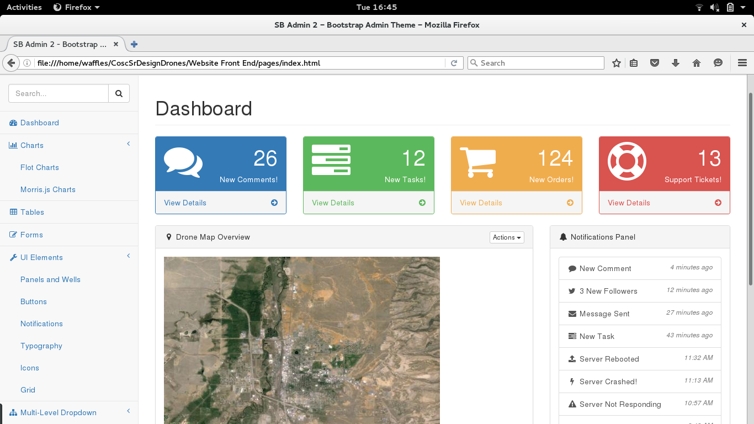

Slide 22
Future Improvements
Low cost hardware upgrades
Move our hardware to the cloud // fly the drone up higher than 200 ft ???
Automatically generated reports
Camera stabilizing mount
Real time video rendering

Slide 23
Q&A?

